Slide 1
Course : Computational Physics and Biology
Effective Period : June 2022
Introduction to Bioinformatics
Session 1

Slide 2
Learning Objectives
Sequence Alignment
Similiarity and Identity
Global and Local Alignment
Simple Alignment & Scoring
BLAST

Slide 3
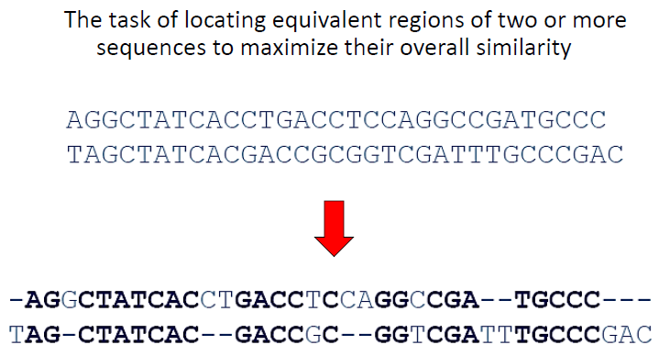
Sequence Alignment
When we have two sets of DNA sequences, as Biologists we would certainly want to know their similarity profile. This is because similarity tells a lot about genetic conservation and their functions.
To be able to do so, a task known as sequence alignment has to be performed to find the blocks of matches and pinpoint any mutation that are of interest. These blocks of matched DNA bases are technically inferring the level of biological conservation between these two sequences.

Slide 4
Sequence Alignment
Identifying similarity between two sequences
2.Sequence specifies the function of a protein
3.Similarity in sequence can imply similarity in function.
•Assign function to uncharacterized sequences based on characterized sequences
4.Sequence from different species can be compared to estimate the evolutionary relationships between species
First of all, we need sequence alignment to identify regions of similarities between sequences. Sequences with high similarities contain similar biological function.
•The level of similarities also contains the information of evolutionary relationships between species. For example comparing between human DNA and the DNA from monkeys.
Sequence Alignment is the KEY to:
1.Finding important regions of interest in DNA, RNA sequences and/or Amino Acid residues.
2.Predict / determine biological functions.
3.Predict / determine / evaluate genetic evolution.

Slide 5
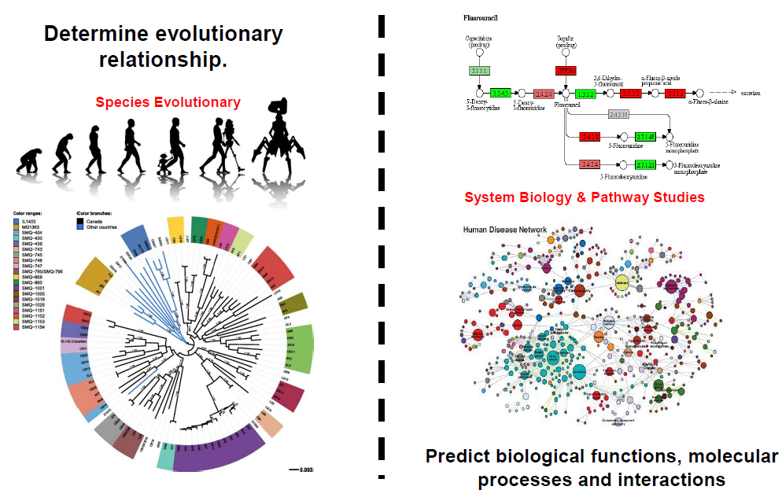
Sequence Alignment
Sequence alignment will be able to uncover the evolutionary relationship between closely and loosely related species. By doing so we will be able to know the history of creation and specific things such as shared genes and unique genes which are important in the study of healthcare, pharmacy and genetic engineering.

Slide 6
Similiarity VS Identity
Term 1 –Similarity
1.Statistical assessment on how well database and query sequences match that can infer homology.
2.This term usually being used in amino acid sequence similarity searching.
Term 2 –Identity
1.Sequence identity is the amount of characters which match exactly between two different sequences.
2.Hereby, gaps are not counted and the measurement is relational to the shorter of the two sequences.

Slide 7
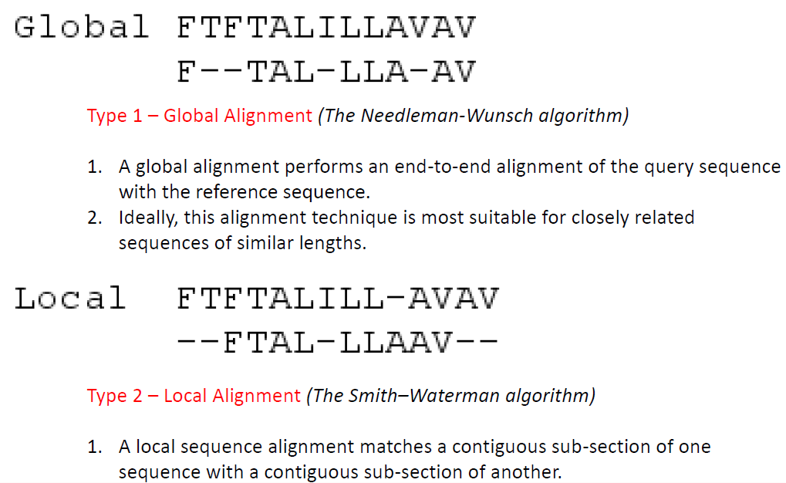
Global VS Local Alignment

Slide 8
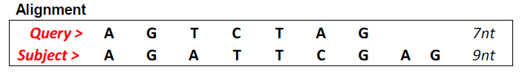
Simple Alignment
Take these two DNA sequences as examples. Consider these questions:
How do I align them?
How do I interpret the alignment?
GAP MATCHED MISMATCHED
The next slides will show you the meaning of these terms.

Slide 9
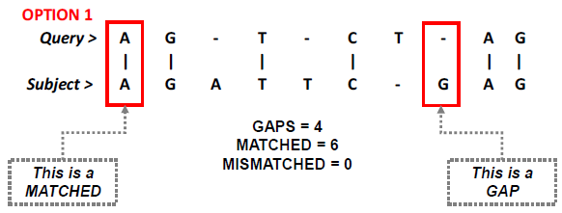
Simple Alignment

Slide 10
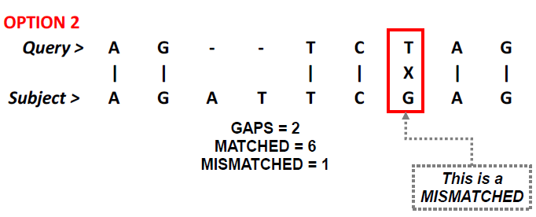
Simple Alignment

Slide 11
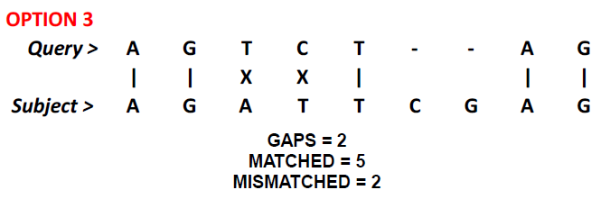
Simple Alignment

Slide 12
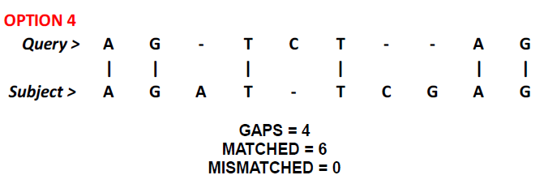
Simple Alignment

Slide 13
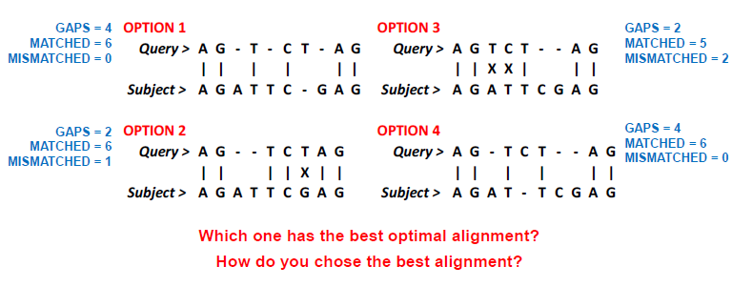
Simple Alignment

Slide 14
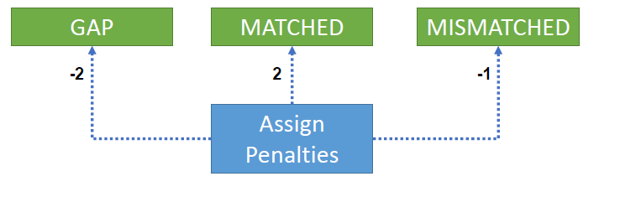
Simple Alignment

Slide 15
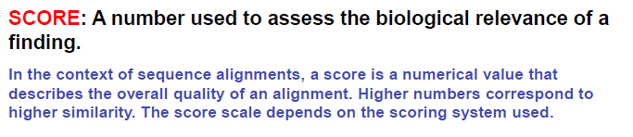
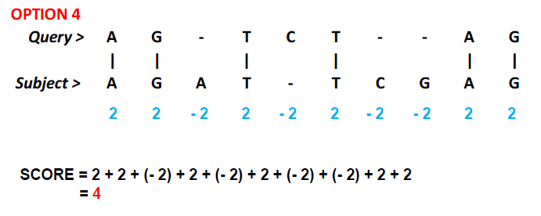
Simple Alignment

Slide 16
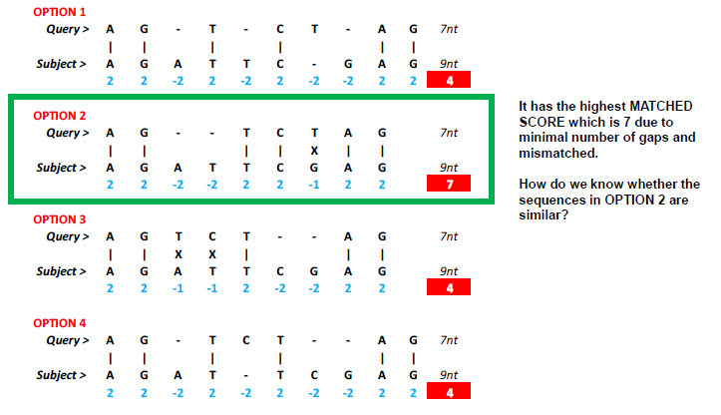
Simple Alignment

Slide 17
Issues in Alignment
1.What type of alignment?
•Align the entire sequence or part of it
2.How to score an alignment?
•The sequences we’re comparing typically differ in length
•Some amino acid pairs are more substitutable than others
3.Algorithms for alignment
4.How to tell if the alignment is biologically meaningful?
•Computing significance of an alignment

Slide 18
Scoring Matrix & Dynamic Programming Algorithm
The aim of a sequence alignment is to match "the most similar elements" of at least two sequences (pairwise alignment). This similarity must be evaluated somehow.
The previous few slides gave you an overview of how to find the best sequence alignment –manually & laborious. Is there any other way?
The answer is yes –we use Scoring Matrix method to align longer and much more complex sequences.
What type of information can I get from this matrix?
We will learn how to compute sequence alignment using dynamic programming (Smith-Waterman Process).

Slide 19
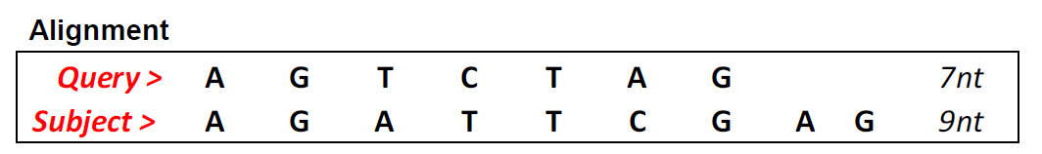
Scoring Matrix & Dynamic Programming Algorithm
How does DPA work? Take these two DNA sequences as examples once again. Consider the same questions:
How do I align them?
How do I interpret the alignment?
Three (3) steps are involved:
Initiation of the scoring matrix
Filling up the scoring matrix
Tracing back (from largest value to 0)

Slide 20
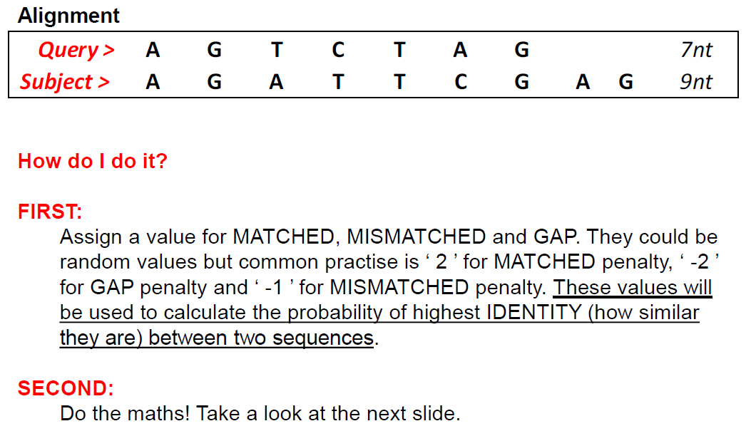
Scoring Matrix & Dynamic Programming Algorithm

Slide 21
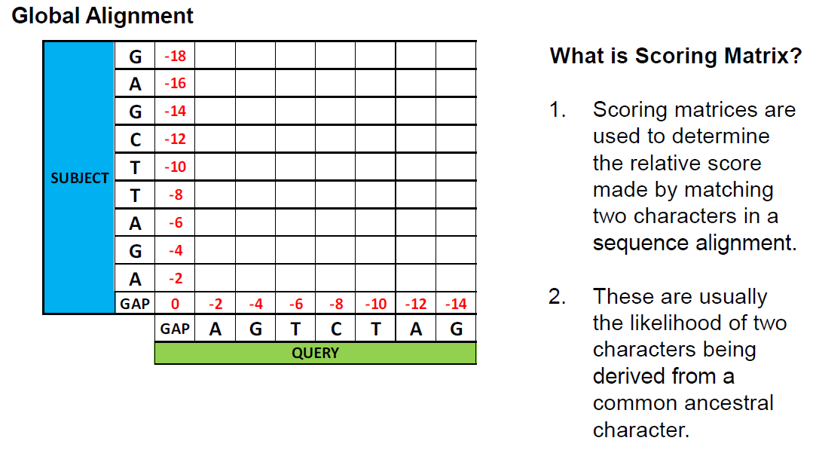
Scoring Matrix & Dynamic Programming Algorithm

Slide 22
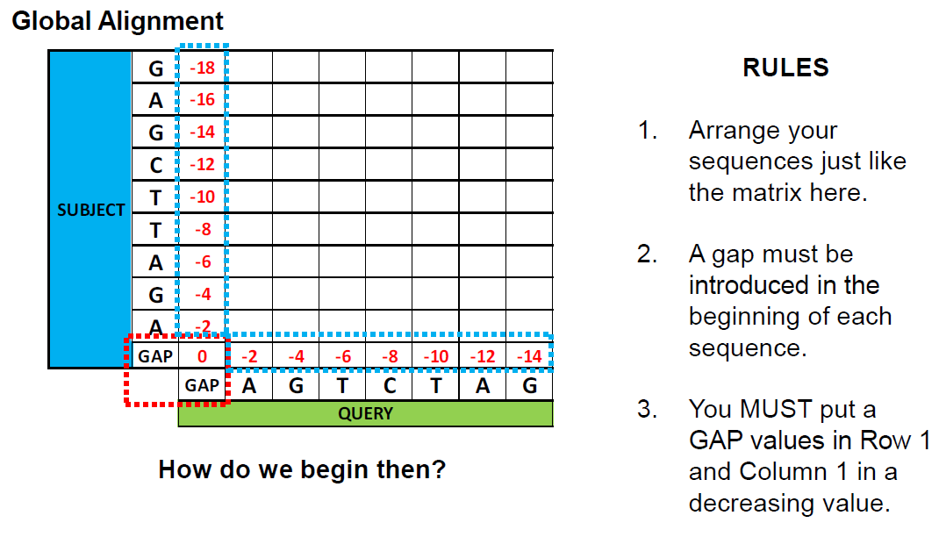
Scoring Matrix & Dynamic Programming Algorithm

Slide 23
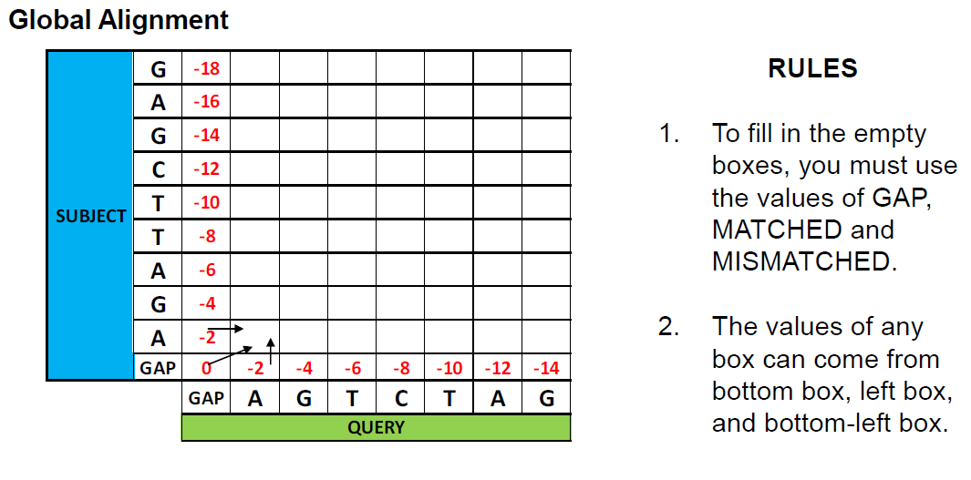
Scoring Matrix & Dynamic Programming Algorithm

Slide 24
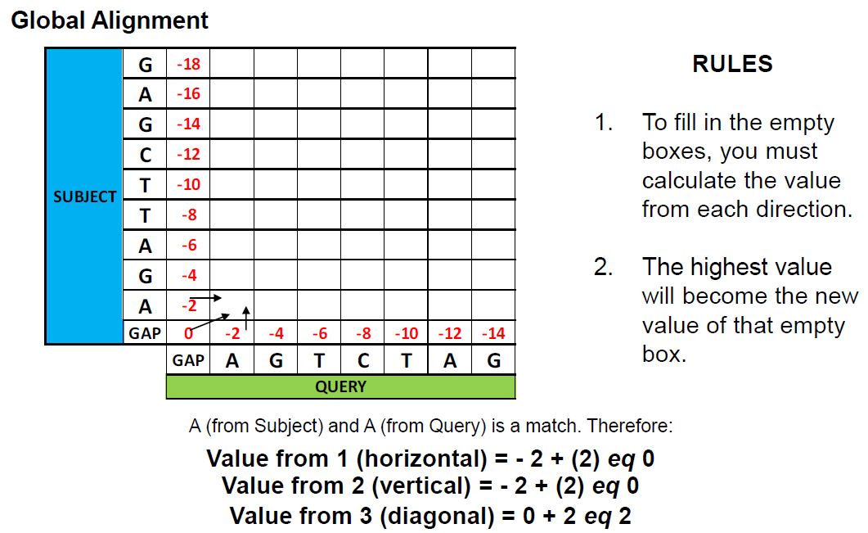
Scoring Matrix & Dynamic Programming Algorithm

Slide 25
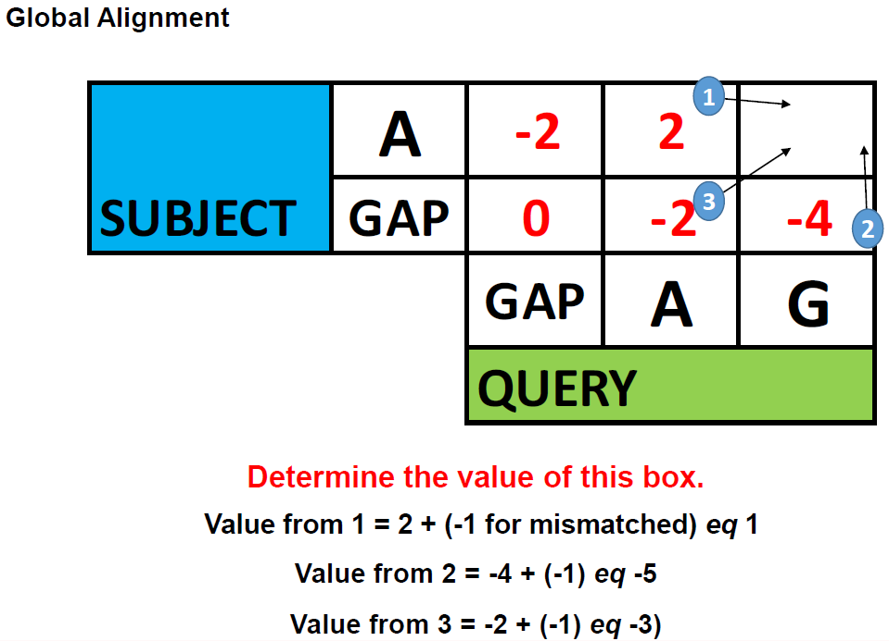
Scoring Matrix & Dynamic Programming Algorithm

Slide 26
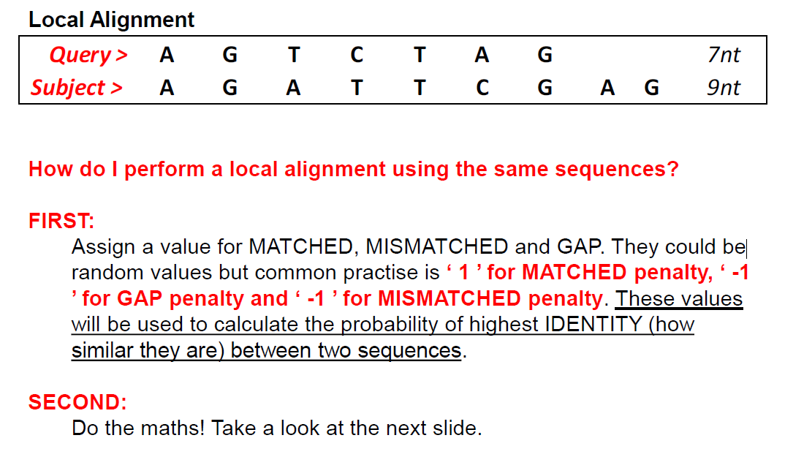
Scoring Matrix & Dynamic Programming Algorithm

Slide 27
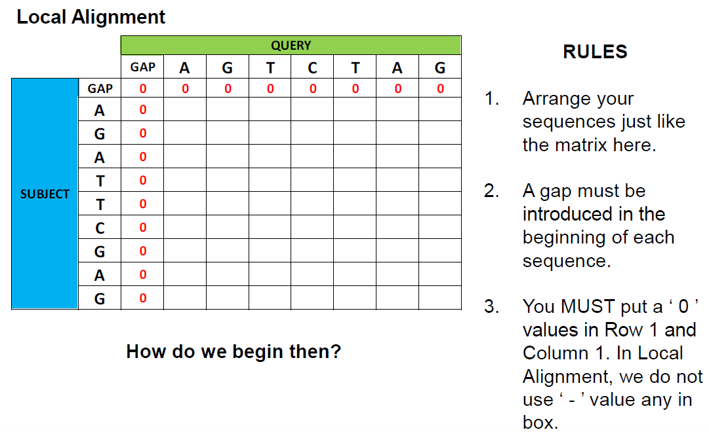
Scoring Matrix & Dynamic Programming Algorithm

Slide 28
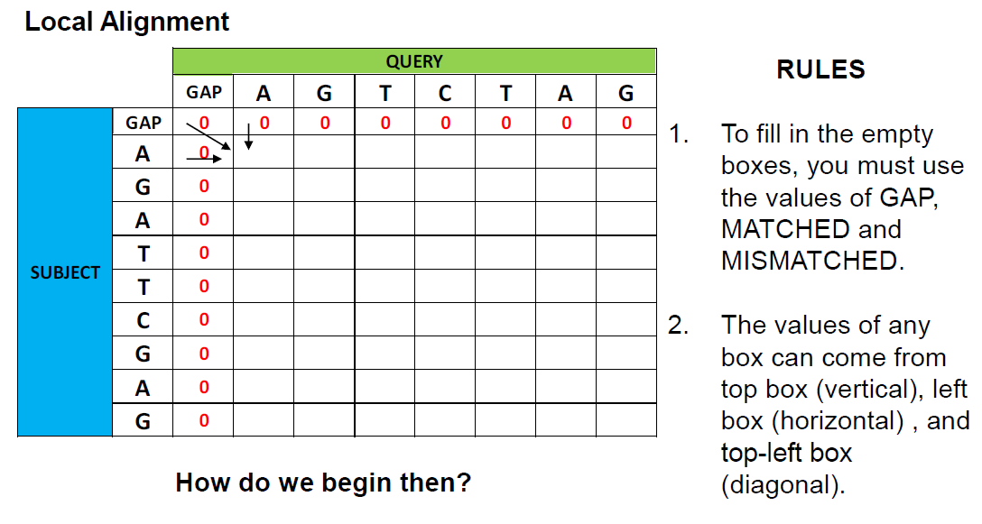
Scoring Matrix & Dynamic Programming Algorithm

Slide 29
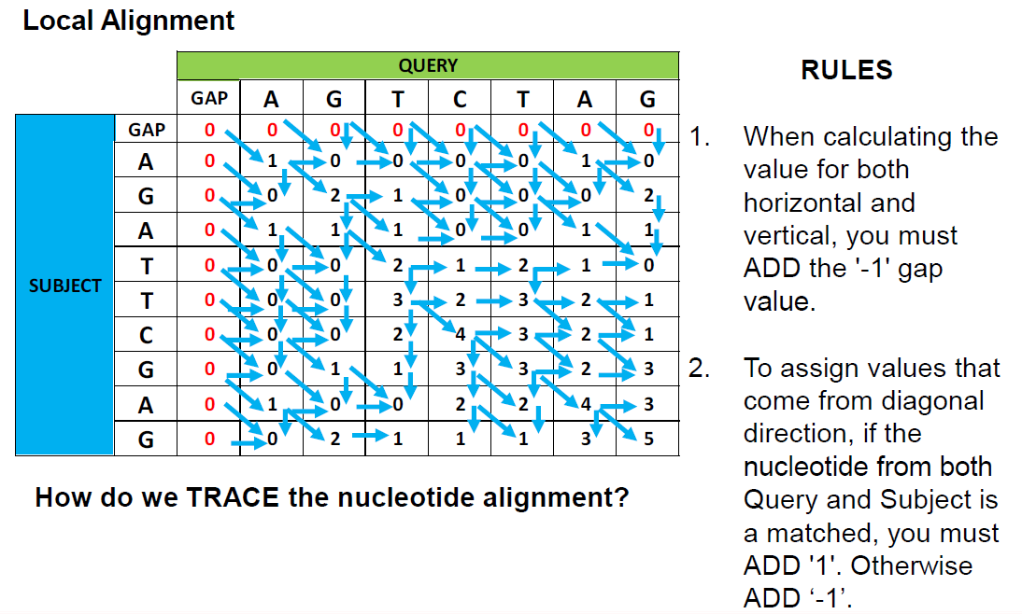
Scoring Matrix & Dynamic Programming Algorithm

Slide 30
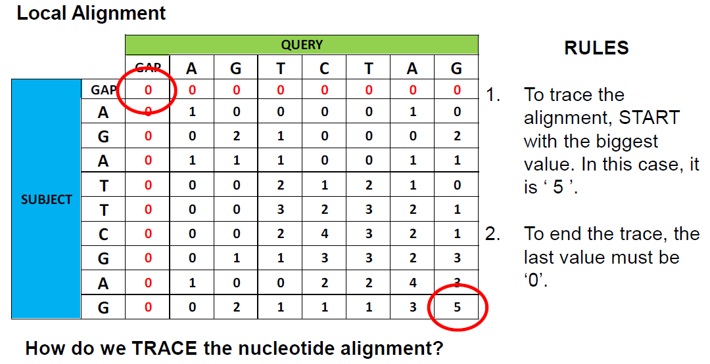
Scoring Matrix & Dynamic Programming Algorithm

Slide 31
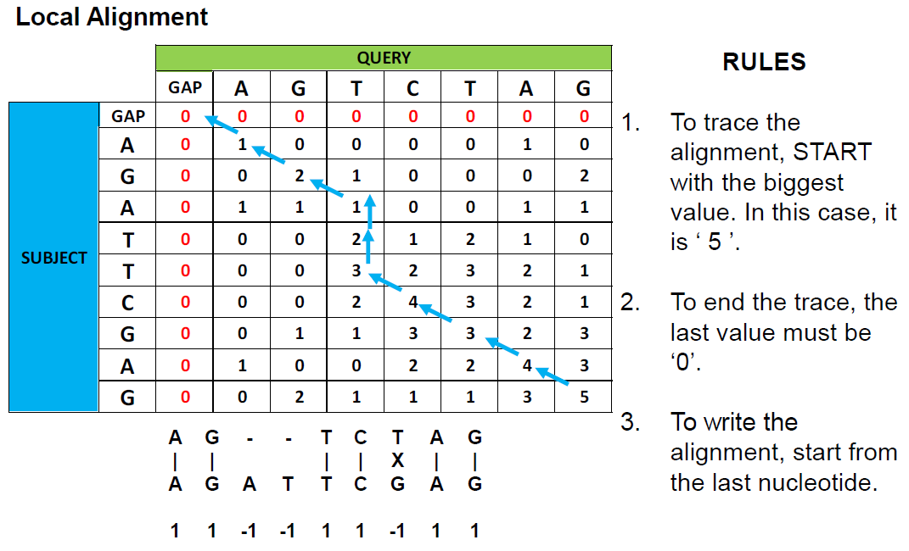
Scoring Matrix & Dynamic Programming Algorithm

Slide 32
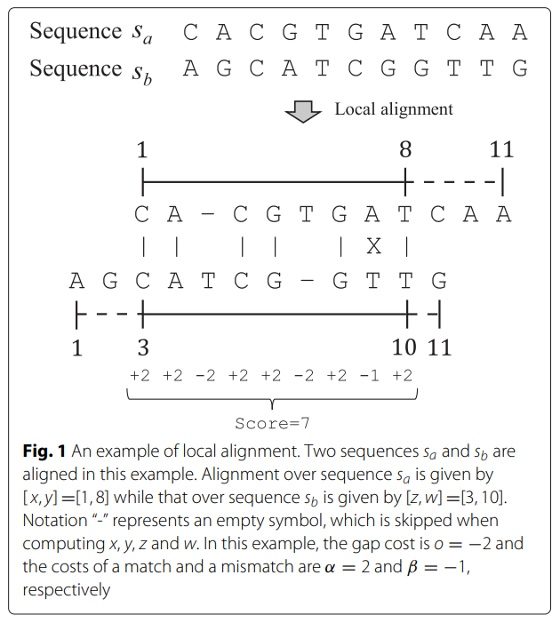
Take home Quiz
Search for this paper
Using 2 sequences given in the paper, try to implement the local or global alignment based on the Dynamic Programming Algorithm
Okada et al. Accelerating the Smith-Waterman algorithm with interpair pruning and band optimization for the all-pairs comparison of base sequences. BMC Bioinformatics. (2015) 16:321

Slide 33
The Basic Local Alignment Search Tool (BLAST)
BLAST finds regions of local similarity between protein or nucleotide sequences. The program compares nucleotide or protein sequences to sequence in a database and calculates the statistical significance of the matches.
BLAST can be used for several purposes.
Identifying species. You can possibly correctly identify a species or find homologous species. This is useful when working with unknown species
Locating domains. When working with a protein sequence you can input it into BLAST, to locate known domains within the sequence of interest.
Establishing phylogeny. Using the results received through BLAST you can create a phylogenetic tree. Phylogenies based on BLAST alone are less reliable than other purpose-built computational phylogenetic methods,
DNA mapping. When working with a known species, and looking to sequence a gene at an unknown location.
Comparison. When working with genes, BLAST can locate common genes in two related species, and can be used to map annotations from one organism to another.

Slide 34
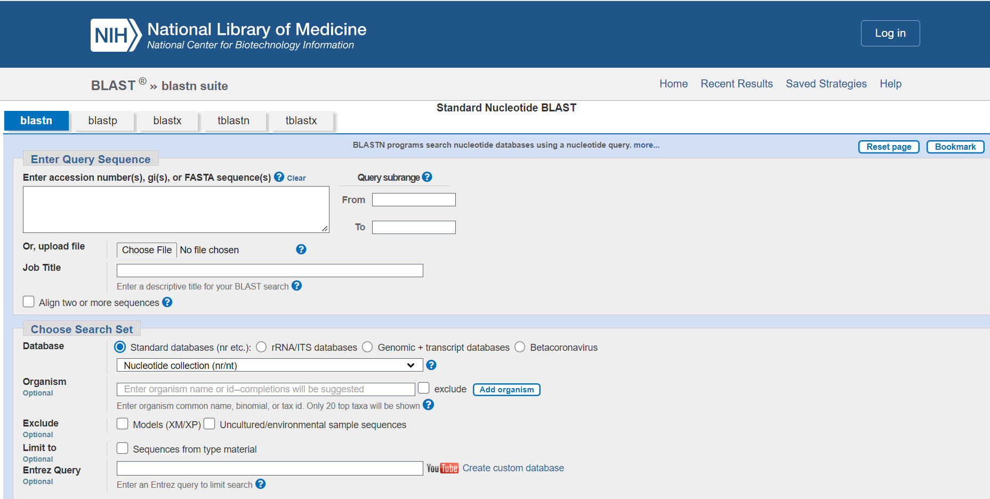
The Basic Local Alignment Search Tool (BLAST)
BLAST tutorial using https://youtu.be/VsrePFFbgE4

Slide 35
The Basic Local Alignment Search Tool (BLAST)
Smith-Waterman and BLAST are used to find homologous sequences by searching and comparing a query sequence with those in the databases, they do have their differences.
Due to the fact that BLAST is based on a heuristic algorithm, the results received through BLAST, in terms of the hits found, may not be the best possible results. A better alternative in order to find the best possible results would be to use the Smith-Waterman algorithm.
The Smith-Waterman option provides better accuracy, in that it finds matches that BLAST cannot, because it does not miss any information.
However, when compared to BLAST, it is more time consuming, not to mention that it requires large amounts of computer usage and space.
However, technologies to speed up the Smith-Waterman process have been found to improve the time necessary to perform a search dramatically. These technologies include FPGA chips and SIMD technology.
Note, that the algorithm used for BLAST was developed from the algorithm used for Smith-Waterman. BLAST employs an alignment which finds "local alignments between sequences by finding short matches and from these initial matches (local) alignments are created".^{[29]}

Slide 36
References

